Slide 1
UML, its Importance, and Applications
The history and origins of UML Goals of UML?
UML and its role in object-oriented modeling and design3
UML Modeling Tools
Sehrish Aqeel
www.aisciences.io

Slide 2
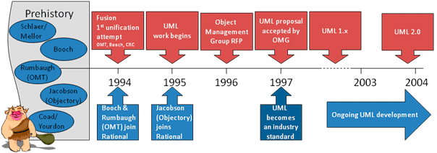
History and Origin of UML

Slide 3
UML and its role in object-oriented modeling and design
UML diagrams are the representation of object-oriented concepts only.
● Thus, before learning UML, it becomes important to understand the OO concept in detail.
● UML can be described as the successor of object-oriented analysis and design.
● UML is linked with object-oriented design and analysis.
● UML use Object Oriented elements and forms associations between them to form diagrams.

Slide 4
UML and its role in object-oriented modeling and design
Following are some fundamental concepts of the object-oriented world:
➔ Class: A class is a blueprint from which individual objects can be created.
➔ Objects: An object represent a particular instance of a class.
➔ Abstraction: Abstraction means hiding implementation details from users.
➔ Encapsulation: Encapsulation is the mechanism that binds together data and code to save from outsiders.
➔ Inheritance: It means taking something that already exists i.e. it provides
reusability.
➔ Polymorphism: It defines the mechanism to exist in different forms.

Slide 5
UML and its role in object-oriented modeling and design
● Step1 is to identify and analyze objects and describe them in a proper way. Objects need to be identified with responsibility i.e. the kind of work they will perform.
● Step 2 is to design. If objects are identified correctly then the design part is easy. In this stage, the objects are collaborated according to their intended association. After the association is complete the design is also complete.
● Step 3 is an implementation in which design is implemented using object-oriented languages like Java, C++, etc.

Slide 6
UML Modelling Tools
Rational Rose
Edraw Max
Adobe Spark
Moqups
Lucidchart
Creately
Visio
ConceptDraw
StarUML
Visual Paradigm
Argouml

Slide 7
UML Modelling Tools: Downloading Links
https://getintopc.com/softwares/development/rational-rose-enterprise-edition-free-download-6136315/
https://www.edrawsoft.com
https://www.adobe.com
https://moqups.com
https://creately.com
https://www.microsoft.com/en-us/microsoft-365/visio
https://www.conceptdraw.com
http://staruml.io
https://www.visual-paradigm.com
https://argouml.en.softonic.com/download

